Slide 1

VNDM2 - Technical Sharing
Dbt Implementation
Chuong.Nguyen​
Dec-2023

Slide 2

Agenda
Recap
Install and configure
Model, materialization
Directory structure
Implementation
From plsql to dbt model
Build
Debug and logging

Slide 3
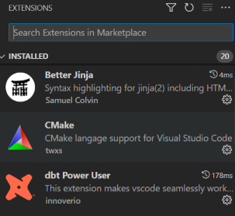
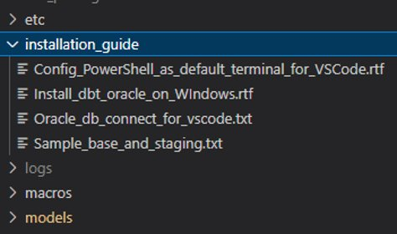
Dbt Installation Check list for Windows
Microsoft Visual C++ : https://visualstudio.microsoft.com/visual-cpp-build-tools/
Download buildtool -> Run file -> Chose Desktop development with C++
VSCode : Visual Studio Code - Code Editing. Redefined
Make sure VSCode have dbt and Cmake extension
Git : Git - Downloads (git-scm.com)
Python : Download Python | Python.org
Update Pip : python.exe -m pip install --upgrade pip
Install Python Virtual Env
Install dbt-core and adaptor (Oracle, Bigquery, DataBrick …)
Project directories : https://git.homecredit.net/country/vn/dataplatforms/pocs/poc_sbv_dbt
Configure connection (profiles.yml)
Notes:
Country / Vietnam / Data Platforms / POCs / POC_SBV_DBT · GitLab (homecredit.net)

Slide 4
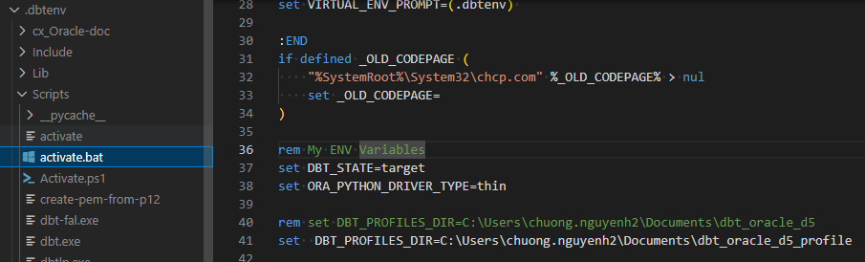
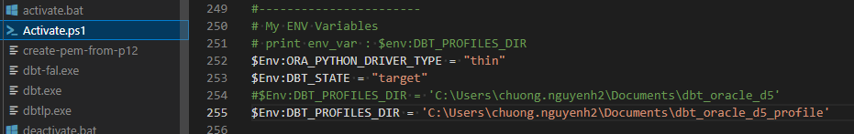
Working Environment variables
Cmd : activate.bat
Powershell: Activate.ps1

Slide 5
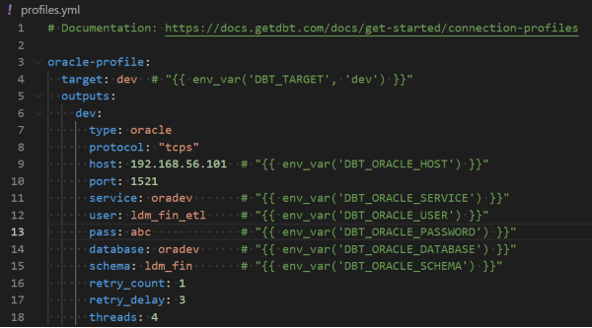
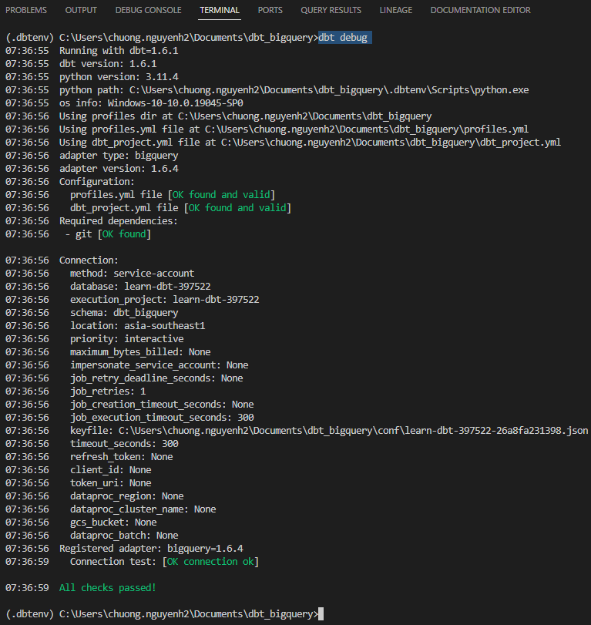
Dbt profile.yml
Configure profile.yml for connection
Check connection : dbt debug

Slide 6
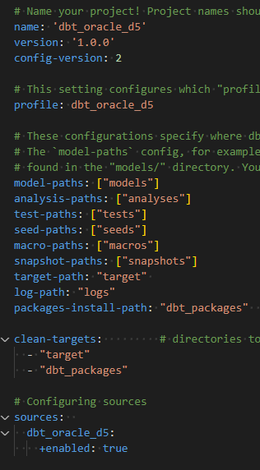
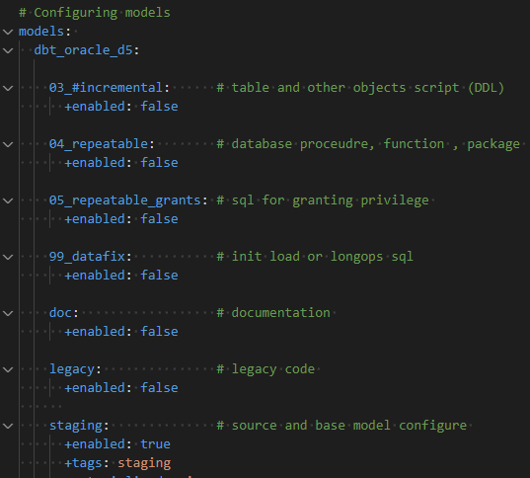
dbt_project.yml

Slide 7
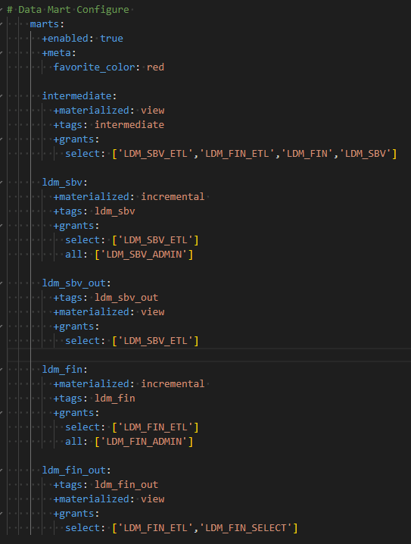
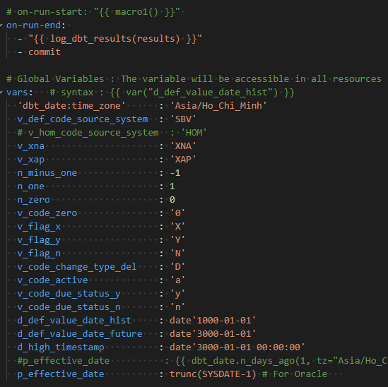
dbt_project.yml

Slide 8
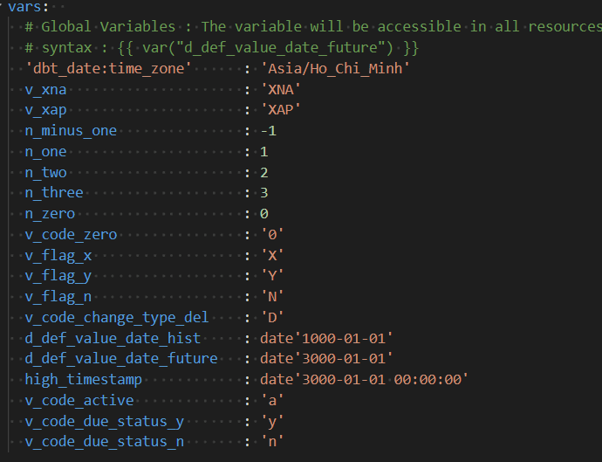
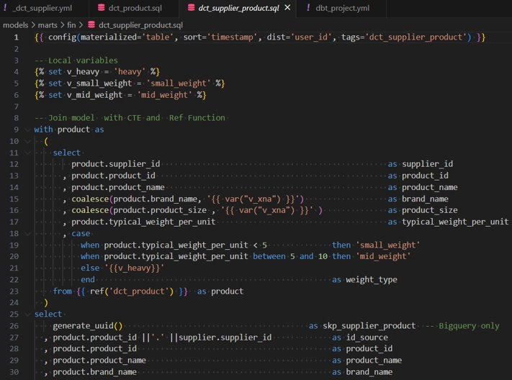
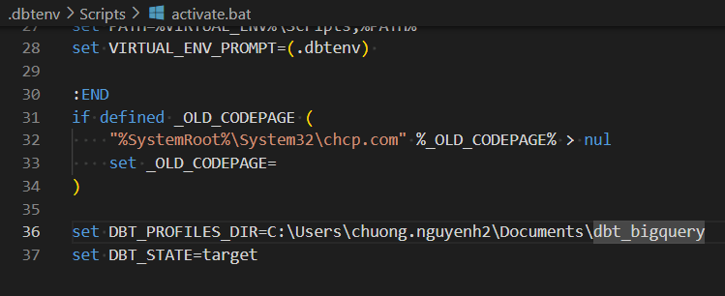
Variable
Global variables
Local variables
Env variables

Slide 9
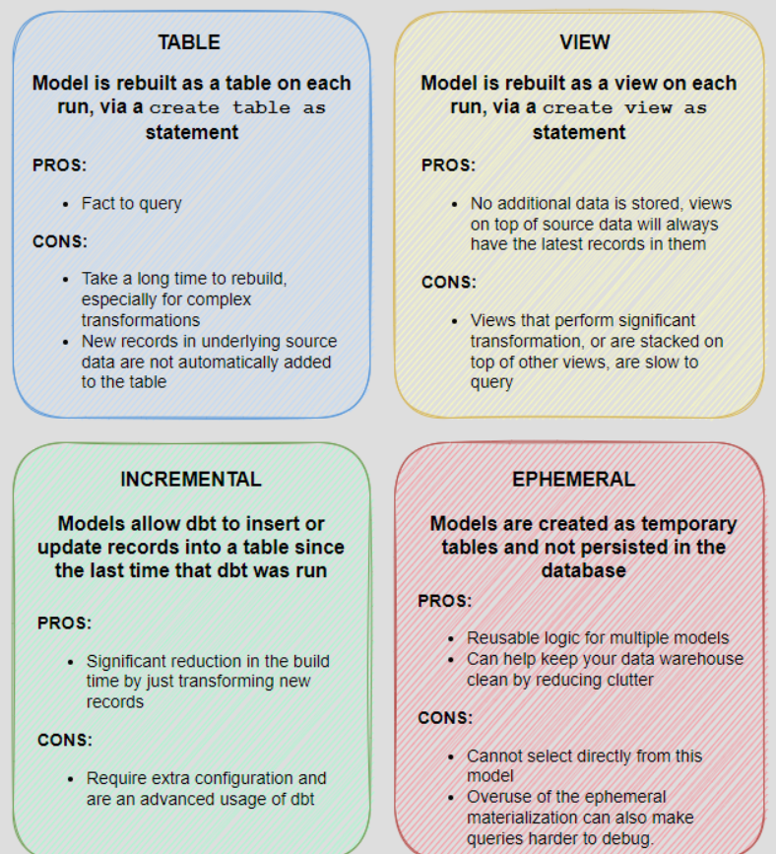
Model Materialization

Slide 10

Dbt Implementation

Slide 11
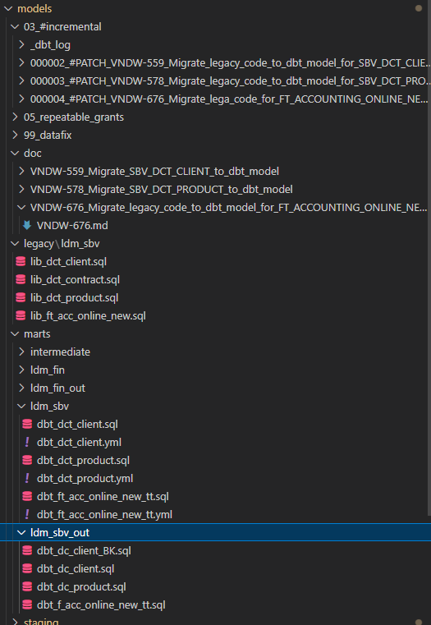
Dbt Project Directories Structure

Slide 12
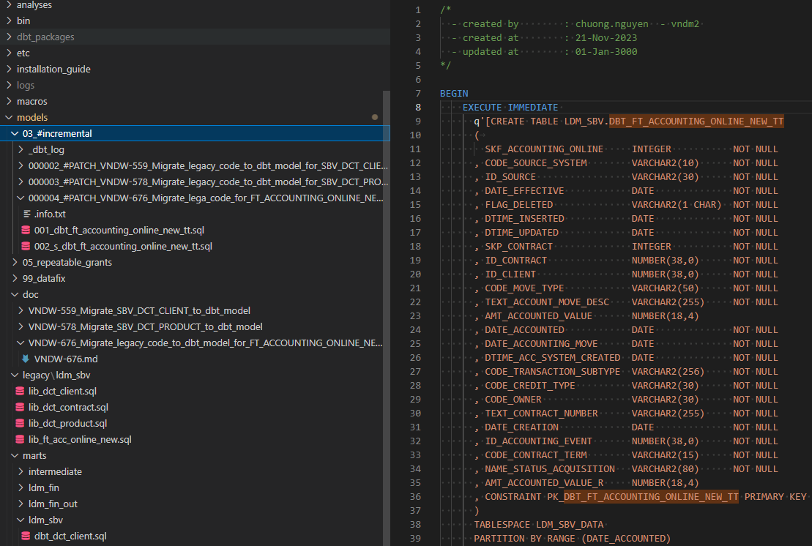
03_#incremental / ddl_scripts

Slide 13
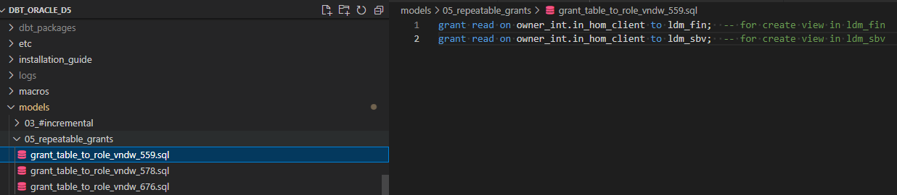
05_repeatable_grants

Slide 14
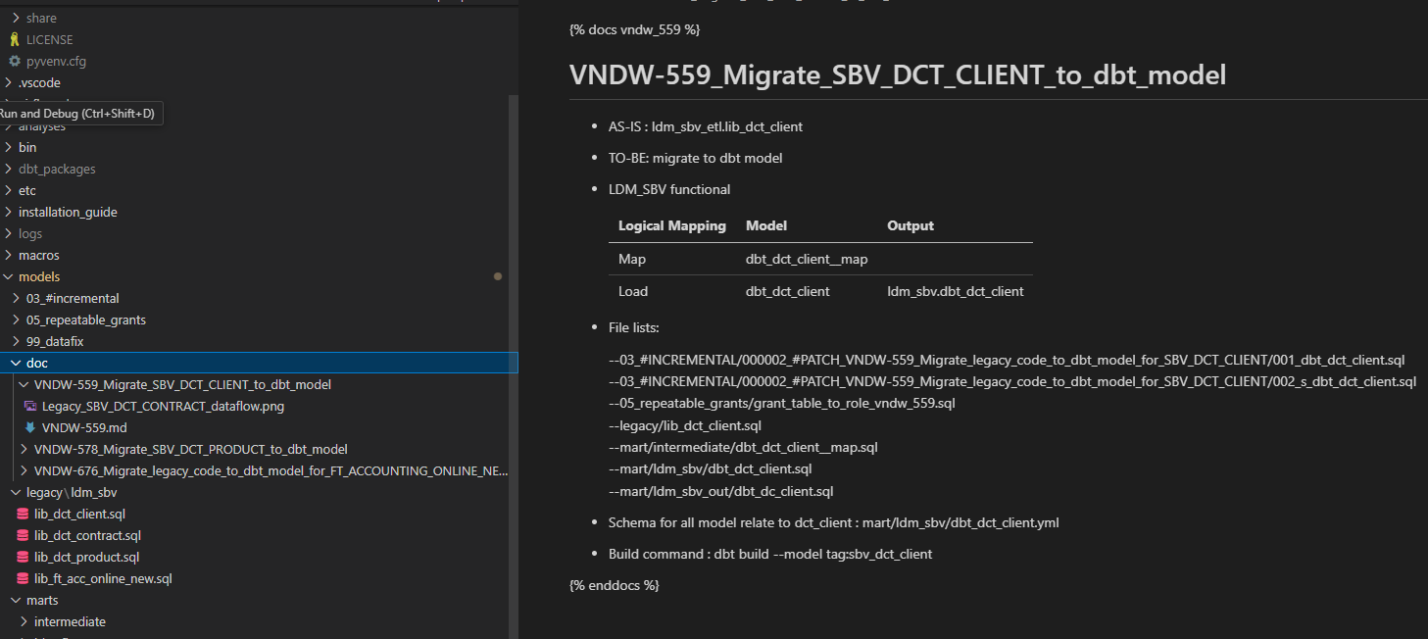
doc

Slide 15
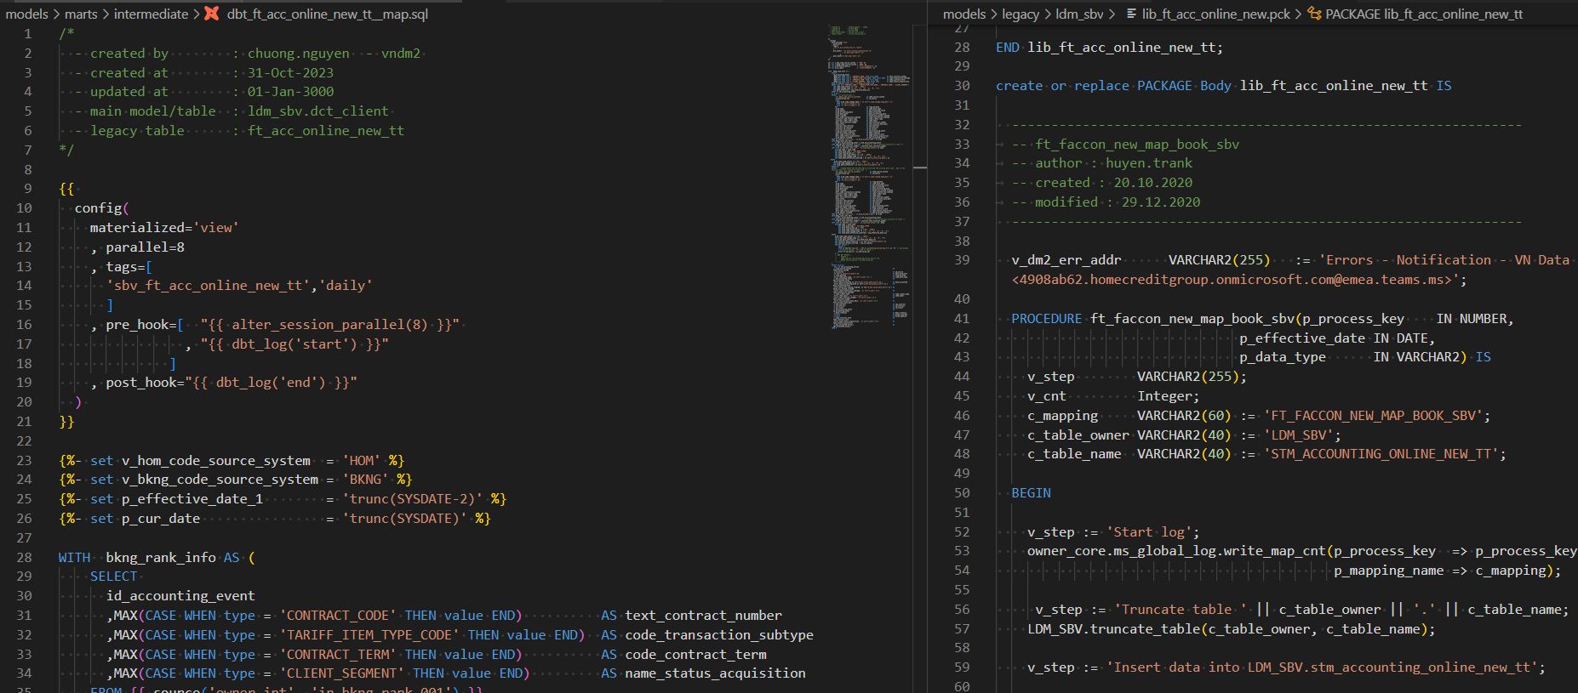
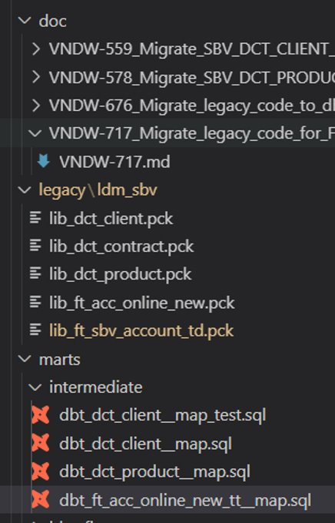
legacy

Slide 16
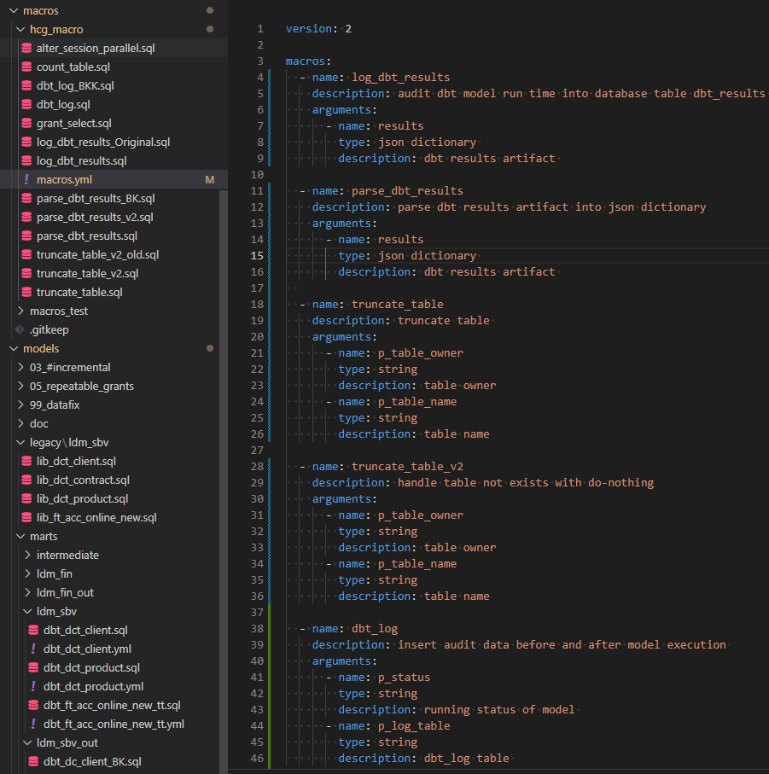
macros

Slide 17
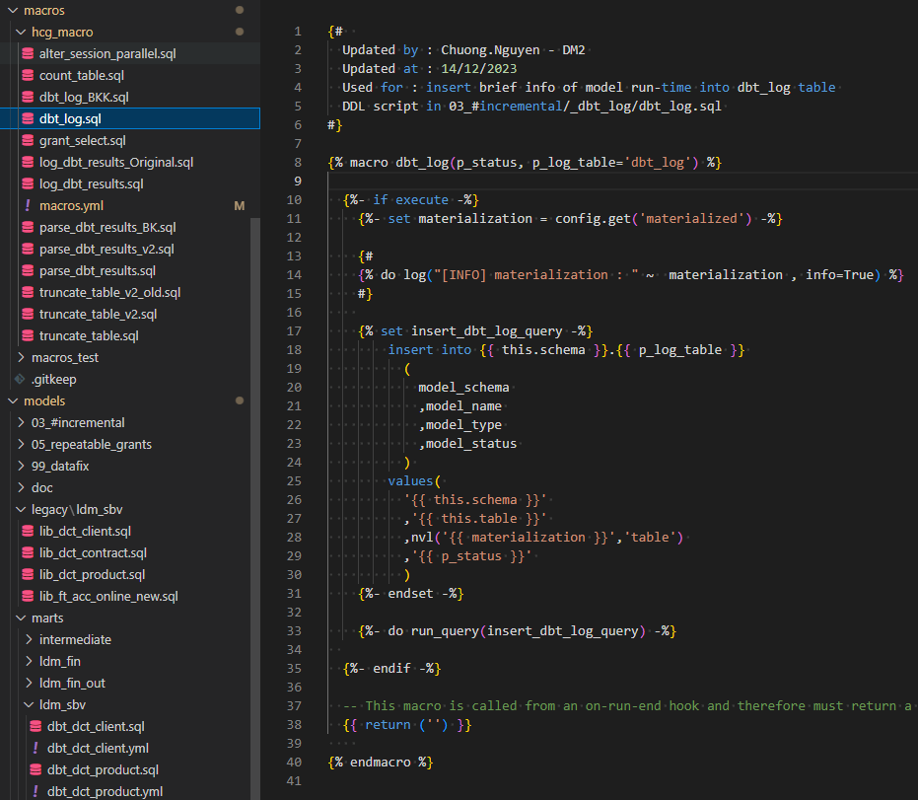
macros

Slide 18
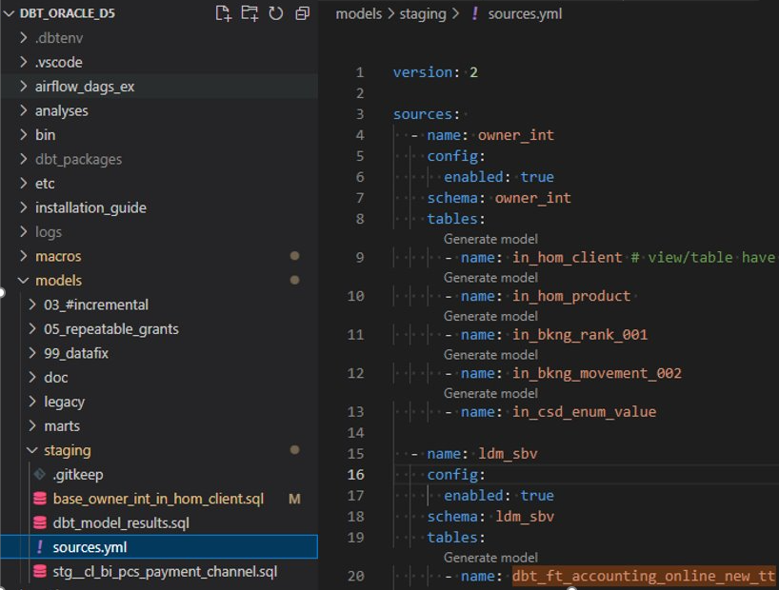
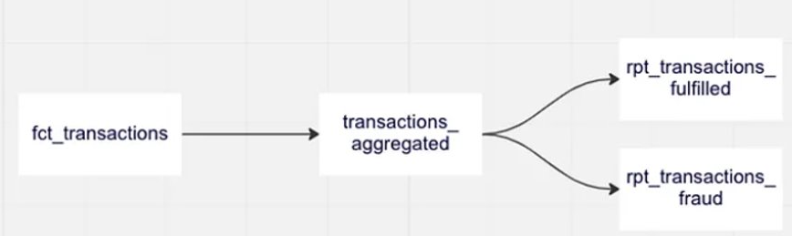
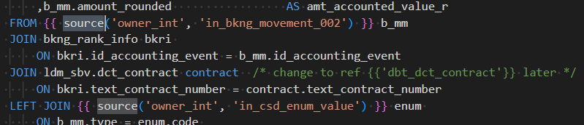
source

Slide 19
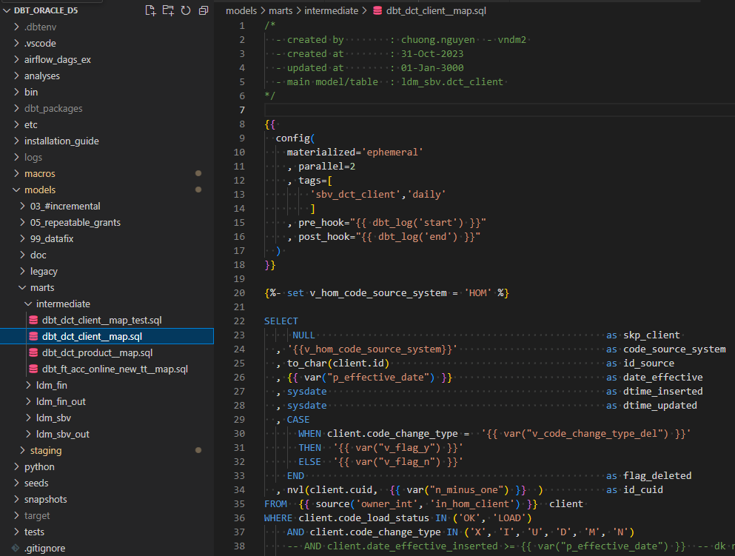
Intermediate – map / diff / temporary

Slide 20
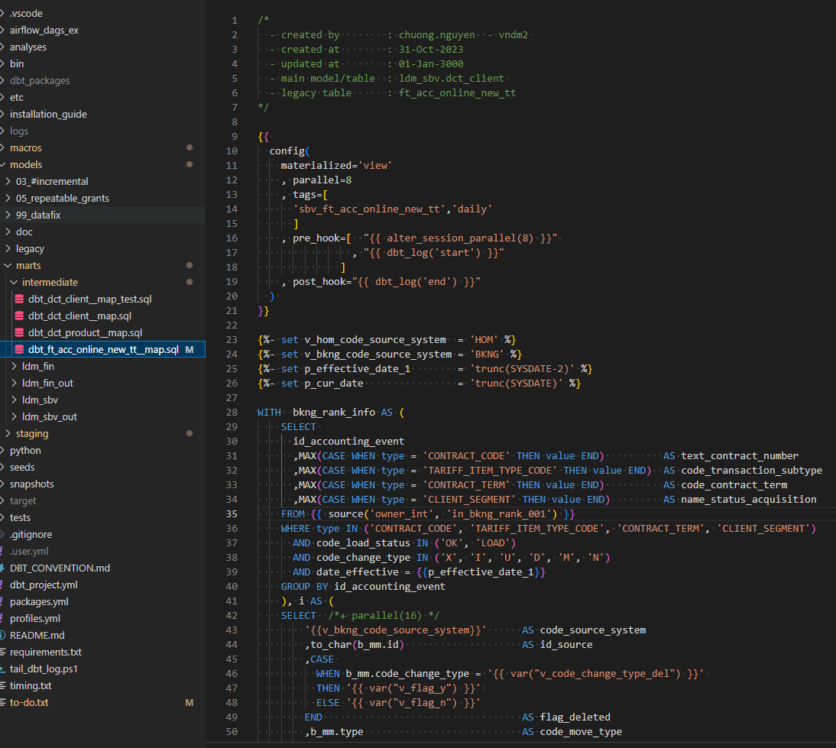
Intermediate – map / diff / temporary

Slide 21
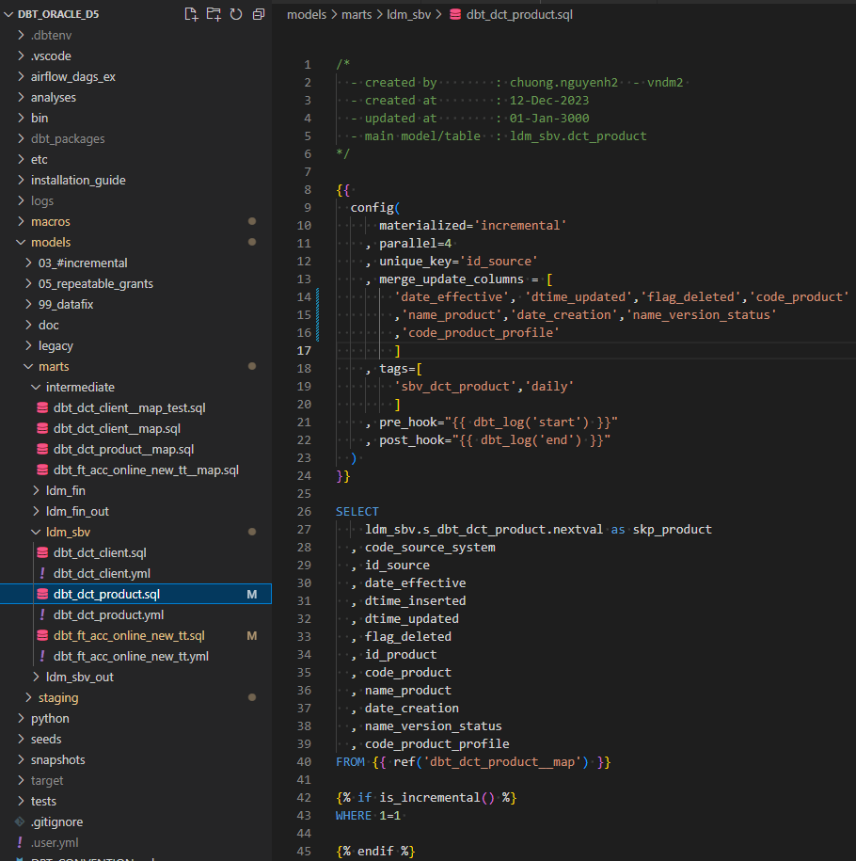
data mart – ldm_sbv

Slide 22
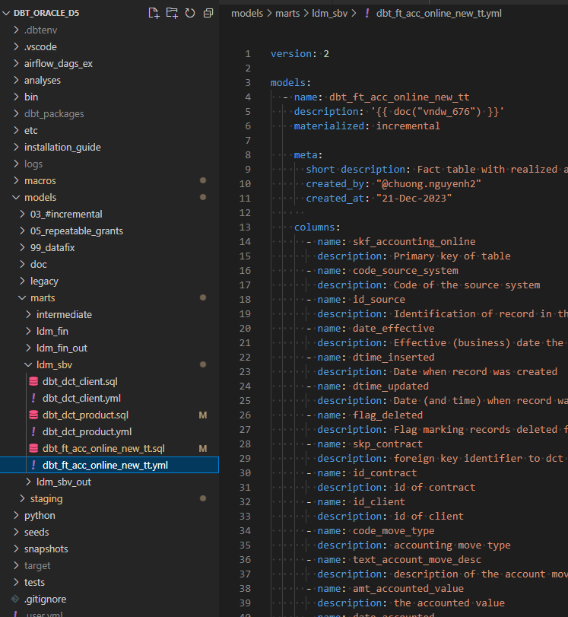
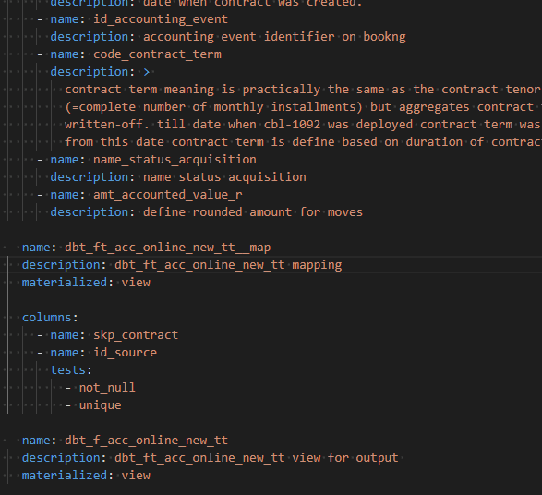
data mart – schema

Slide 23
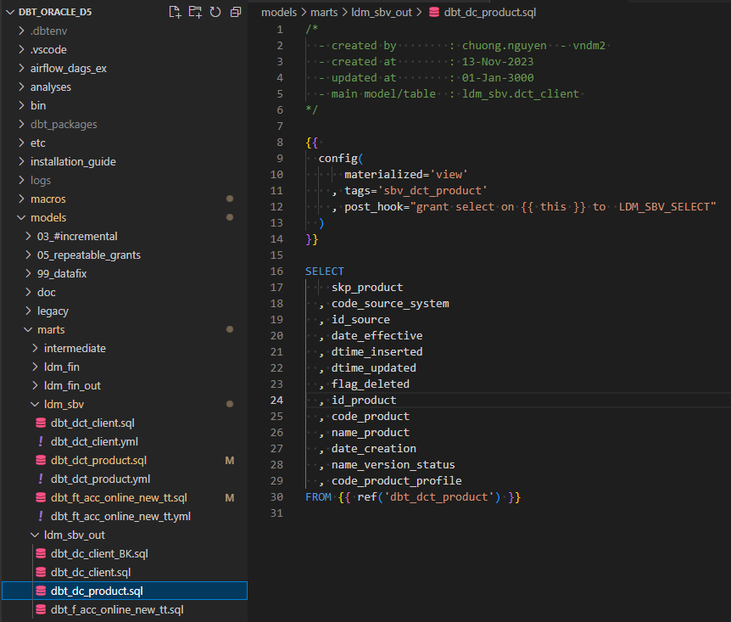
output data

Slide 24
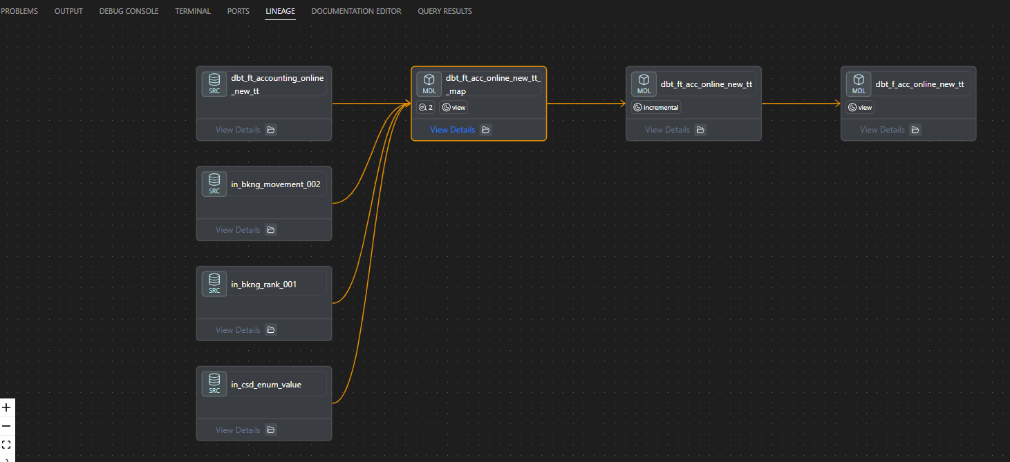
Data linage
Notes:
Remember to install dbt Power User plugin

Slide 25
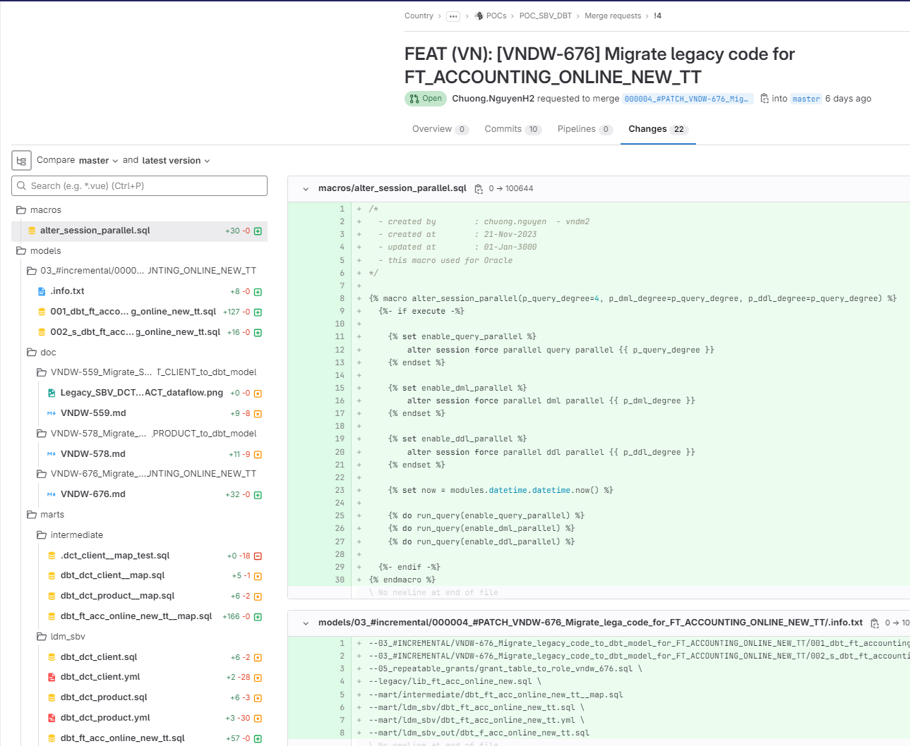
https://git.homecredit.net/country/vn/dataplatforms/pocs/poc_sbv_dbt
Git repo

Slide 26
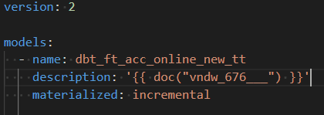
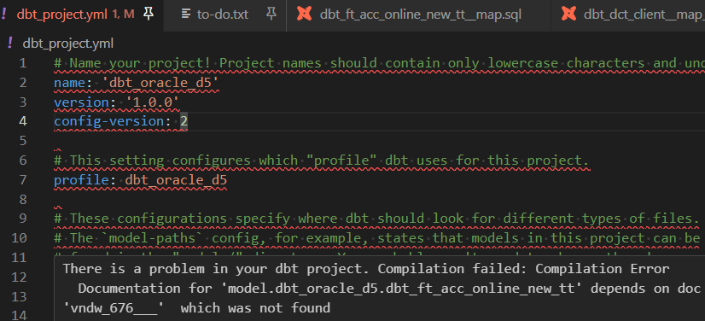
Debug
Compile error auto detect
Dbt.log
Target
Compiled
Run

Slide 27
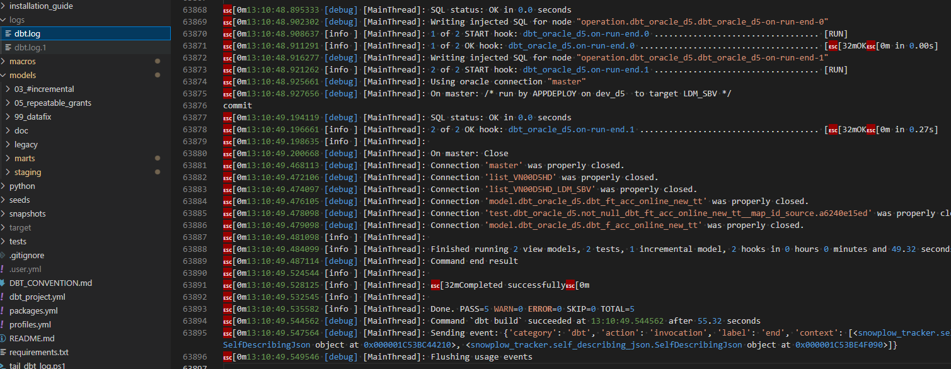
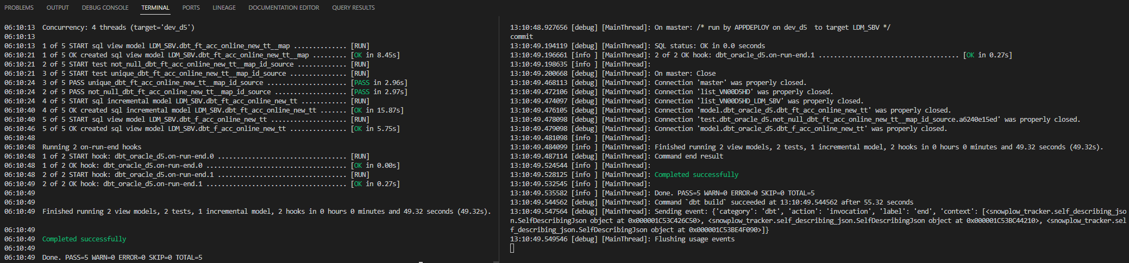
Dbt.log

Slide 28
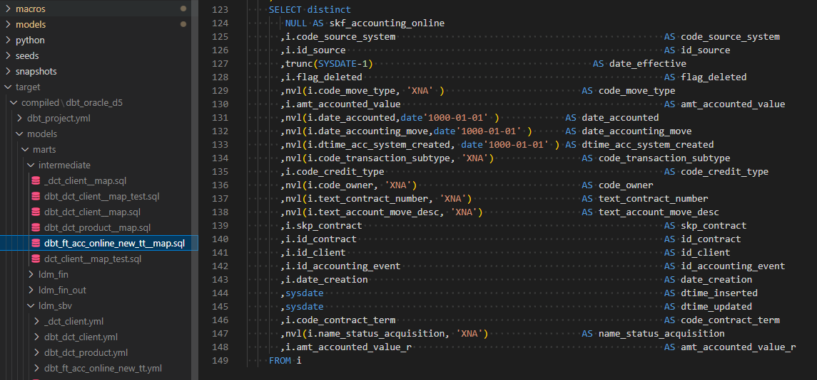
target/compiled

Slide 29
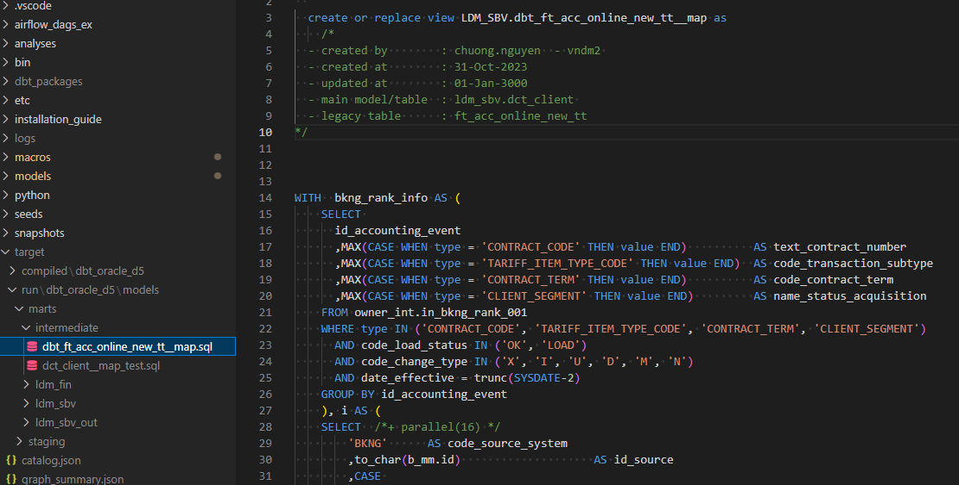
target/run

